Slide 1

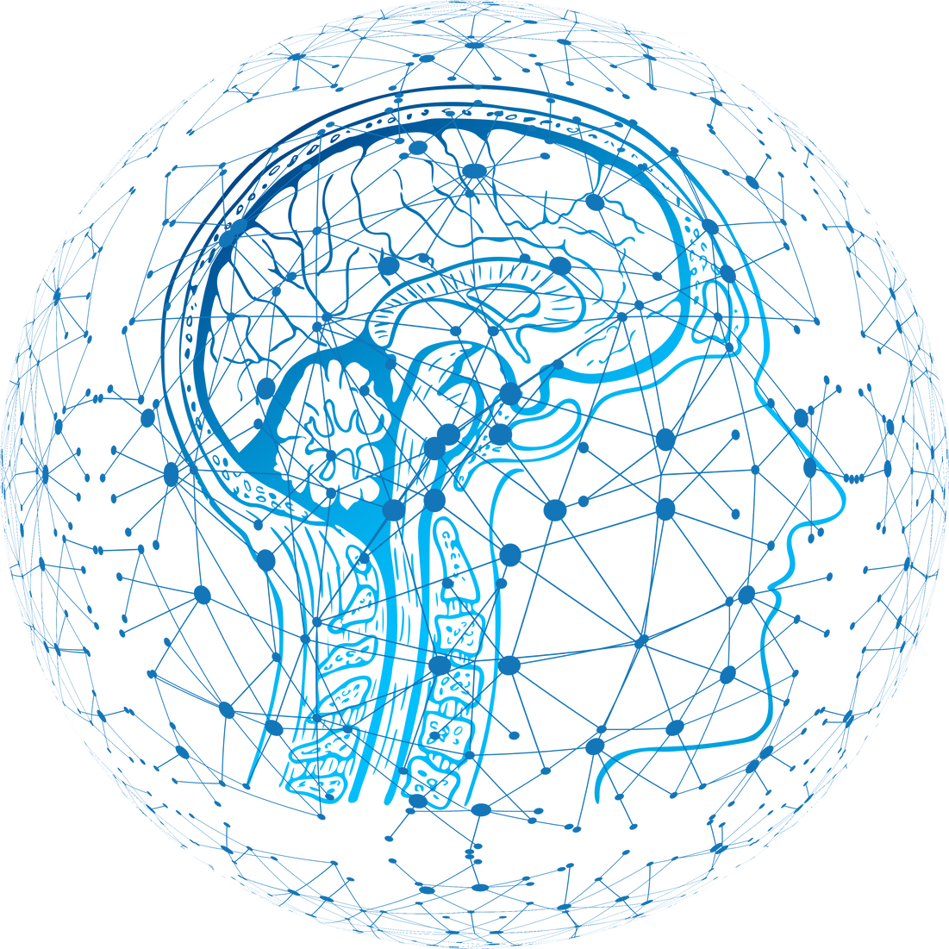
Department of Software Engineering Capstone Project Phase B
Braude College of Engineering, Israel Project 24-1-R-9
Generating Multi-scale Graphs with
Graph U-Net
Shachar Dalal Shahar Vachiler
205799976 314761065
Supervisor - Prof. Zeev Volkovich
01

Slide 2

AGENDA
Introduction
Model
Data
The Process
Results
Conclusion
02

Slide 3
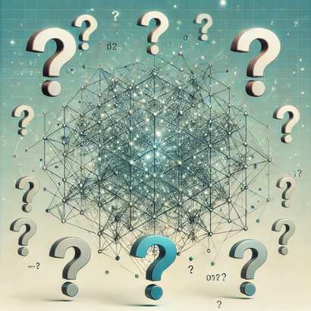
Introduction
Purpose
01
Graph generation suggests creating graph structures modeling desired relationships between objects, this is essential for applications like social networks, bioinformatics, and recommendation systems.
A common problem of graph generation methods lies in their inability to efficiently capture hierarchical relationships.
Possible unsuccessful modeling leads to incomplete data representations, resulting in suboptimal performance across various applications.
03

Slide 4
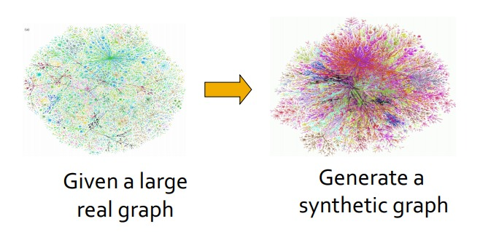
Introduction
Solution
02
To address those issues, we consider a new model within the known Misc-GAN framework architecture.
The proposed model uses the GU-net's capabilities to capture the hierarchical complexity of the given graph and incorporates a new diffusion-based approach for graph generation.
04

Slide 5
The model
Model
The first step consists of the data pre-processing.
Based on the inherent architecture, the project also is composed of three main modules:
Testing and evaluation are used to test the resulting graph.
Graph representation module
Graph generation module
Graph reconstruction module
05

Slide 6
Model
Pre-process
Covert the dataset into the desired format .
01
Remove irrelevant data.
02
Padd missing nodes.
03
Pre-train the GU-net.
04
06

Slide 7
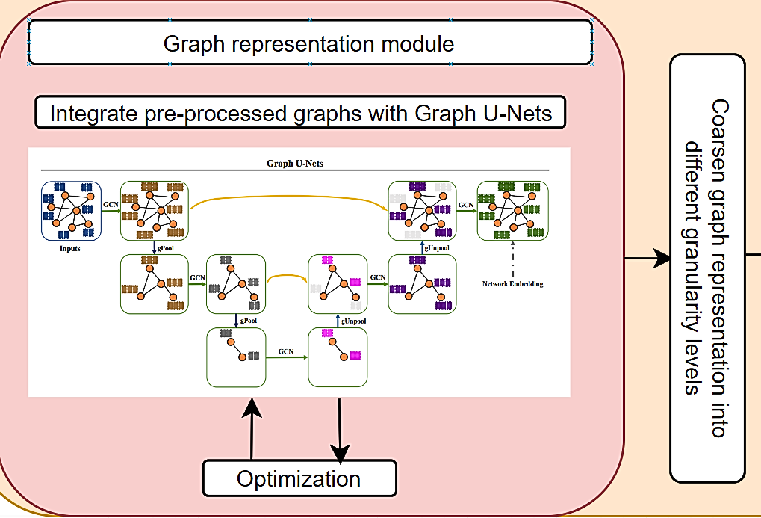
The model
01
Graph representation module
After pre-processing, complex graph structures is captured in different granularity level using the Encoder of GU-net model.
07

Slide 8
The model
GraphARM
autoregrresive diffusion model for graph generation or in short GraphARM generates graphs by progressively adding nodes and connections in a discrete graph space, absorbing or masking nodes in the forward process and reconstructing them in reverse.
A denoising network predicts node types and edges during reconstruction, leveraging a learned node ordering that captures graph structural regularities.
This approach enhances efficiency, accuracy, and allows for greater control by easily integrating constraints compared to traditional diffusion models.
08

Slide 9
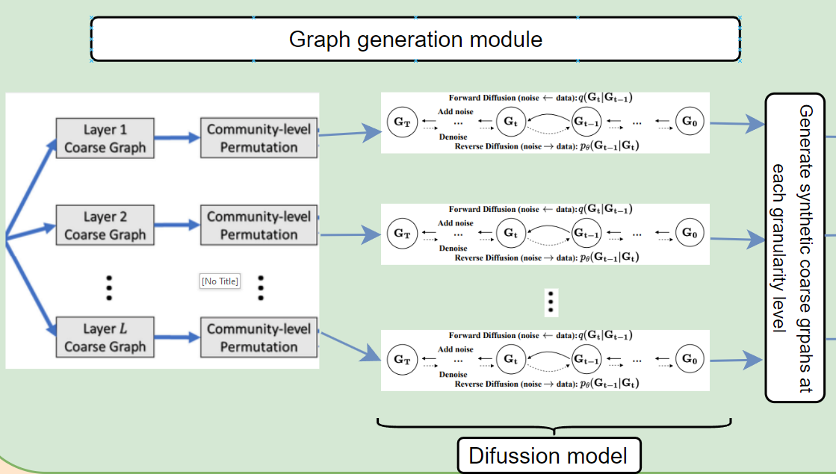
The model
02
Graph generation module
Each coarsen graph is separately fed to the diffusion model, aiming to generate various target graphs as the base of the Graph Reconstruction Module.
09

Slide 10
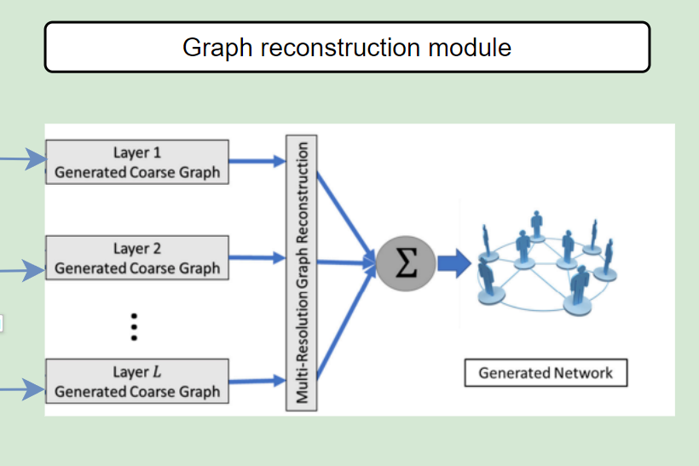
The model
03
Graph reconstruction module
Combining all coarsen graphs to restore the compressed graph using the decoder part of the GU-net model.
10

Slide 11
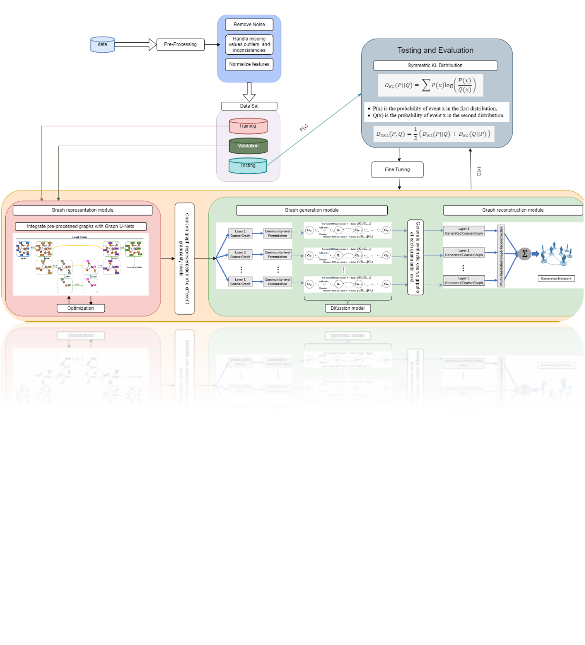
The model
04
The general process
11

Slide 12
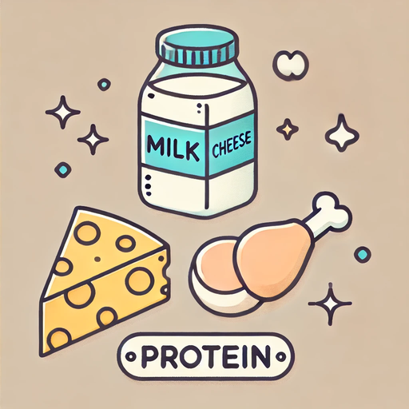
Datasets
The following datasets involved in our study:
01
PROTEINS
The Proteins dataset represents a biological network, where the nodes correspond to proteins and edges represent interactions between the proteins.
The Proteins dataset consists of 1113 proteins, each classified as an enzyme or a non-enzyme. The interaction network consists of 1673 links, representing the interactions between the proteins.
12

Slide 13
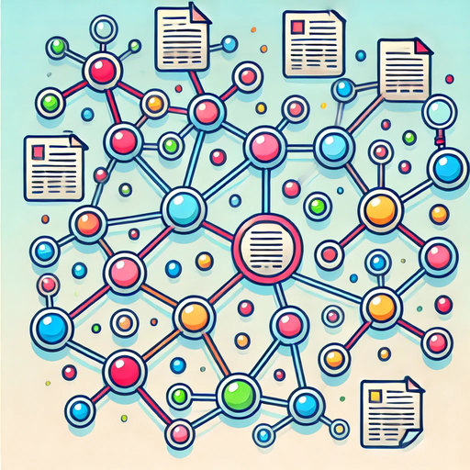
Datasets
02
CORA
The Cora dataset represents a citation network, where nodes correspond to scientific publications and edges represent citations.
The Cora dataset consists of 2708 scientific publications classified into one of seven classes. The citation network consists of 5429 links.
The Cora dataset is divided into seven classes of machine learning topics.
13

Slide 14
The process
Process
The development process of the project consisted of the next steps:
Identify the input and output objects required for proper program functionality.
01
Train the GU-net model using a properly structured dataset.
02
Adjust the seed dataset to fit the required input format of the GU-net model.
03
Integrate GU-net's gPool and gUnpool operations.
04
Replace CycleGAN with an Autoregressive diffusion model for graph generation.
05
14

Slide 15

The process
Training
The GU-net model is trained on the Proteins dataset.
Both the MISC-GAN framework and the GraphARM diffusion model are trained on the Cora dataset, which focuses on node classification.
Each training process is conducted on 200 epochs and divided into batches in size 32.
15

Slide 16
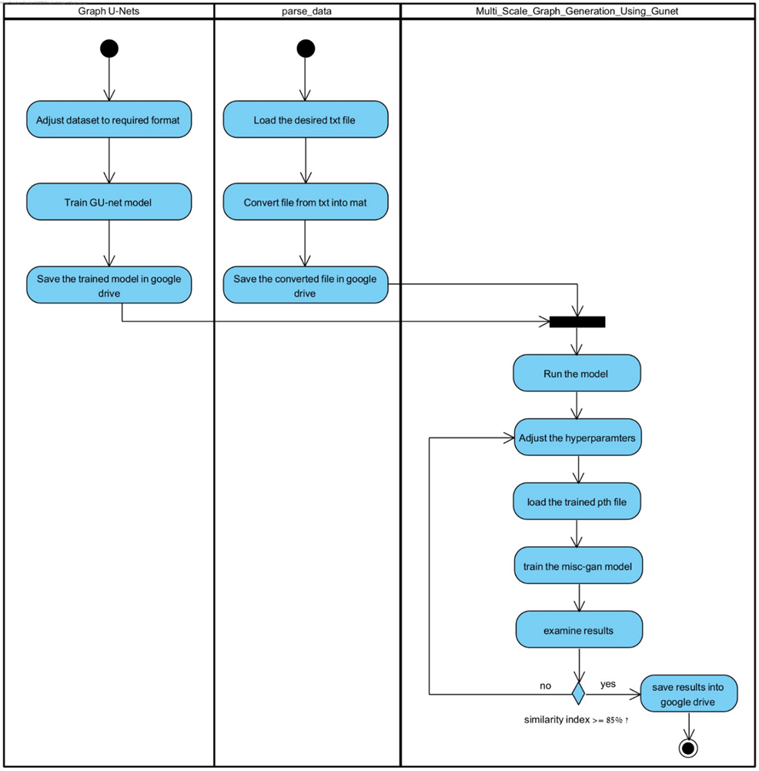
The process
The following is the Activity diagram of the proposed system
16

Slide 17
Results
Similarity index
Similarity Index is a quantitative measure used to assess how closely a generated graph replicates the original graph structure.
It evaluates the preservation of key features, including:
A higher value indicates the generated graph retains more similarities with the original, while a lower value suggests significant alterations in the graph structure.
Node connectivity
Clustering
Overall topology
17

Slide 18
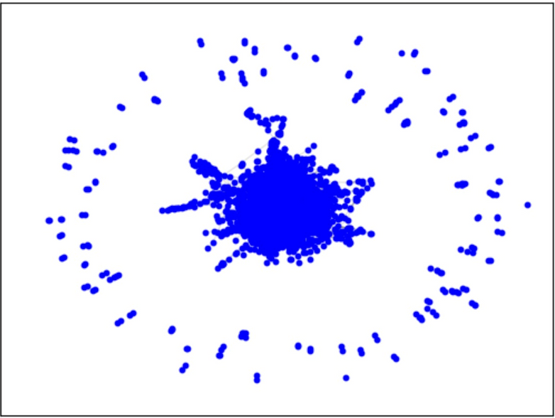
Results
01
Original Graph
The plot below shows the original input graph structure compared to the results of the GU-net and diffusion models.
•In the original graph, the nodes are densely concentrated in the projection plot with a uniform circular structure.
18

Slide 19
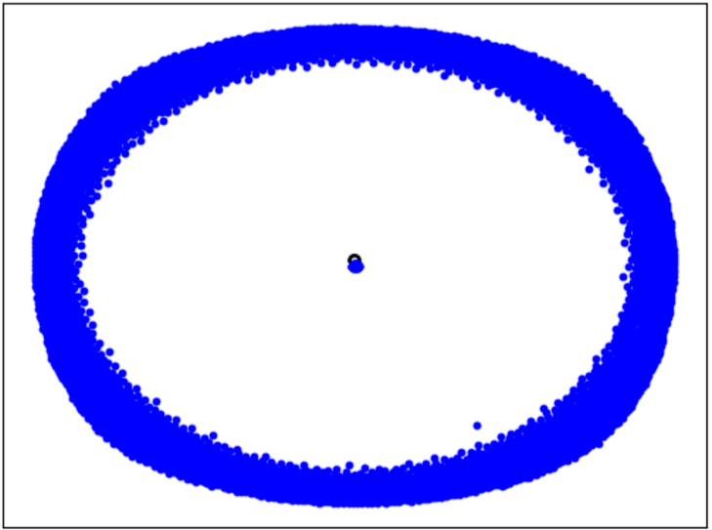
Results
02
Generate graph using CycleGAN
The projection plot below shows the output graph using the GU-net gPool and gUnpool operation before integrating the diffusion model.
This outcome shows more uniformity but loses the dense core. The structure appears more circular and smooth, yet lacks the detailed clustering of the original graphs.
Similarity index ~ 60%
19

Slide 20
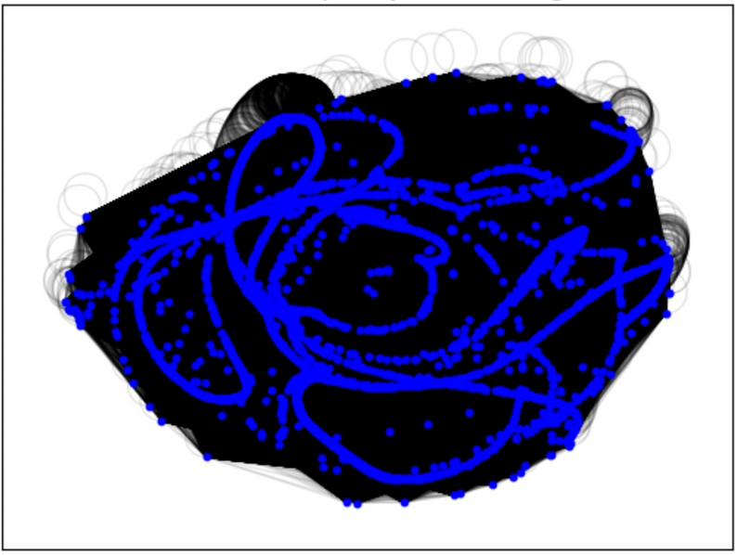
Results
03
Generate graph using GraphARM
The projection plot below shows the output graph after full integration of the GU-net and GraphARM diffusion model.
The graph appears to be more chaotic and irregular, with dispersed patterns, loops, and clusters that do not exist in the original.
Similarity index < 20%
20

Slide 21
Results
Results summary
While the original graphs show a close correspondence between node and edge distributions, both models (CycleGAN and GraphARM) exhibit inconsistent edge patterns, with GraphARM producing more intricate but less meaningful connections.
CycleGAN with GU-net provides smoother, more consistent results compared to GraphARM, but both models struggle to capture the inherent original graph’s structure and connectivity, indicating further improvement is needed in graph replication.
21

Slide 22
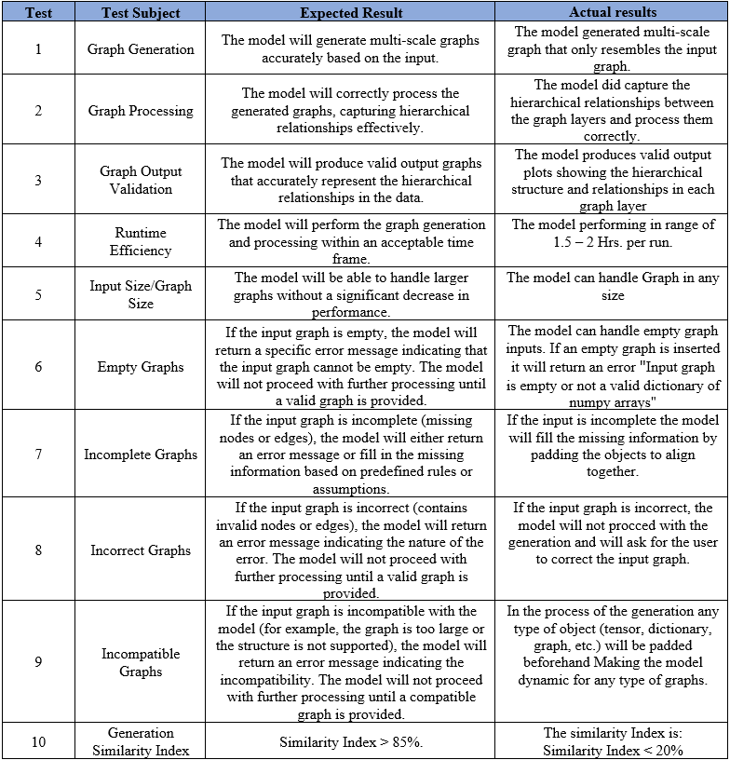
Testing plan
The following is the Testing plan of the proposed system as presented in phase A of the project with the addition of the actual result
22

Slide 23
Conclusion
Conclusion
We researched a new approach combining GU-net with GraphARM to generate multi-scale graphs, focusing on capturing complex structural relationships.
The simulated graphs are generally inherent in the structured properties of the basic graph.
To improve performance, we could explore alternative diffusion models better suited to the task and refine the integration of GU-net, addressing padding and structural challenges in its training.
23

Slide 24
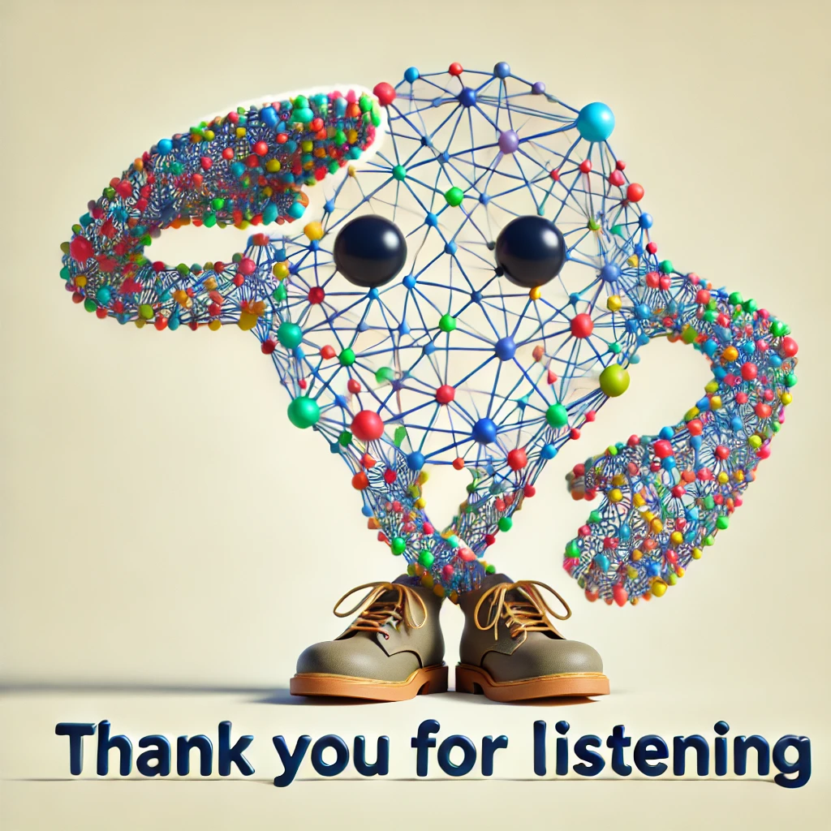
24

